Slide 1
Getting started with BDD
By: Radwa Sadek
Principal Test Engineer, Cegedim
Linkedin: https://www.linkedin.com/in/radwa-sadek-9042354/

Slide 2
Agenda
Introduction
What is manual testing?
What is automation testing?
Test automation benefits
Which Test Cases to Automate?
What not to Automate?
Automation Process
Popular Test Automation Testing Tools
BDD definition
BDD pros
Tools used to apply BDD
BDD syntax
Feature components
Example

Slide 3
Introduction
In the software testing world, there are two types of testing techniques:
Manual testing,
Automated testing
Both kinds aim to execute the test case, then compare the actual outcome with the expected result.
Automation is a process using which we can automate a manual process with the use of technology.

Slide 4
What is manual testing?
Manual Testing is a testing technique performed by a human sitting in front of a computer carefully executing the test steps to ensure the software code does anything it is supposed to do.

Slide 5
What is automation testing?
On the contrary,…
Automation Testing is a software testing technique that is performed using special automated testing software tools to execute a test case suite.

Slide 6
Test automation benefits
If you are familiar with testing, you understand that successive development cycles require the execution of the same test suite repeatedly. This process can be extremely repetitive and time-consuming if you perform it manually. However, by leveraging a test automation tool, it is easier to write the test suite, re-play it as required, mitigating human intervention, and improving testing ROI.

Slide 7
Test automation benefits summary
Manual Testing of all workflows, all fields, all negative scenarios is time and money consuming
Test Automation in software testing does not require Human intervention. You can run automated test unattended (overnight)
Automation testing helps in reducing the test execution time.
Automation helps increase Test Coverage of application features
Reliable in results
Ensure Consistency
Saves Time and Cost
Improves accuracy
Increases Efficiency
Re-usable test scripts
Test Frequently and thoroughly
More cycle of execution can be achieved through automation
Early time to market

Slide 8
Which Test Cases to Automate?
Which Test Cases to Automate?
High Risk – Business Critical test cases
Test cases that are repeatedly executed
Test Cases that are very tedious or difficult to perform manually
Test Cases which are time-consuming

Slide 9
What not to Automate?
The following category of test cases are not suitable for automation:
Test Cases that are newly designed and not executed manually at least once
Test Cases for which the requirements are frequently changing
Test cases which are executed on an ad-hoc basis.
Lack of expertise of the automation tool
Incorrectly chosen test cases

Slide 10
Automation Process
Step 1) Define scope of Automation
Step 2) Test Tool Selection
Step 3) Planning, Design and Development
Step 4) Test Execution
Step 5) Maintenance

Slide 11
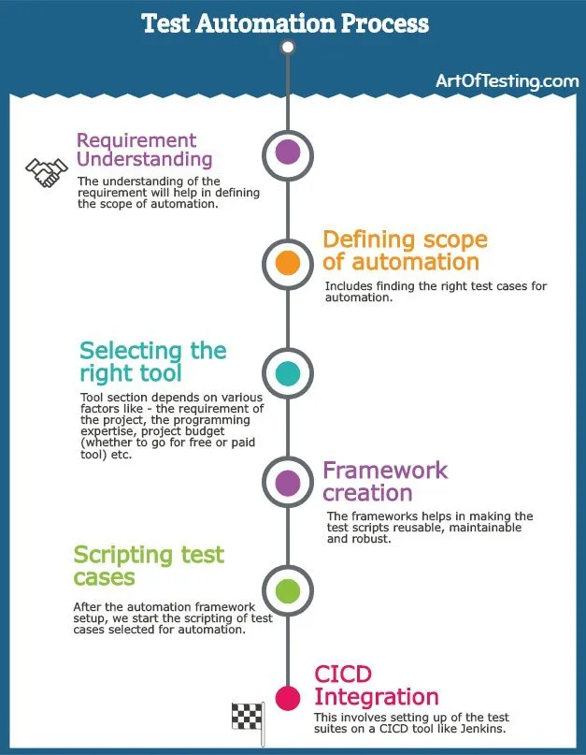

Slide 12
Define scope of Automation
The scope of automation means the area of your Application Under Test that will be automated. Make sure you know:
your team’s test state
the amount of test data
the environment where tests take place
Technical feasibility
The complexity of test cases
The features or functions that are important for the business
The extent to which business components are reused

Slide 13
Test Tool selection
After determining your scope, it is now the time for you to pick up a tool for automation testing. Of course, you can select it from a wide range of automation tools available in the market. Yet, it solely depends on the technology on which the application tests are built. Each type of tool or framework may serve different demands, therefore having a thorough understanding of multiple tool types is also a prominent factor in choosing your best tool.

Slide 14
Test Tool selection (cont.)
Factors to consider:
Cross Operating Systems
Cross Automation Platforms
Supported Programming Languages
Supported Test Runners
Supported Automation Technologies
Element Locating Technique
Built-in UI Inspection Tool
Page Object Model (POM) Support
Coding Skills Required
Record & Playback
Built-in DevOps Integrations

Slide 15
Test Tool selection (cont.)
Price
Environment Support
Ease of use
Testing of Database
Error Recovery Testing
Support for various types of test – including functional, test management, mobile, etc…
Support for multiple testing frameworks
Easy to debug the automation software scripts
Ability to recognize objects in any environment
Extensive test reports and results
Minimize training cost of selected tools

Slide 16
Planning, Design and Development
Here, you will create an automation strategy and plan. This plan can include the following items:
Your selected automation testing tool
Framework design and its features
A detailed timeline for scripting and executing test cases
In-scope and Out-of-scope items of automation
Goals and deliverables of automation testing process

Slide 17
Execute Test Cases and Build your reports
Once finishing all of the preceding steps, it is time to take action! You can write the scripts, run the test automatically, either by running the code directly or by calling an application’s API or user interface. After your execution, the test report provides a consolidated summary of the testing performed so far for the project.

Slide 18
Maintaining previous test cases
No matter how well you manage the automation testing, test maintenance is unavoidable if you want to expand your collection of reusable test scripts. Once your automated tests have been scripted and running, they still need updating if the application changes the next time.

Slide 19
Popular Test Automation Testing Tools
Selenium
Katalon Studio
TestComplete
Appium
Ranorex
Cucumber

Slide 20
BDD definition
Behavior driven development (BDD) framework is an Agile software development process that encourages collaboration among development team and non-technical or business participants in a software project.
It encourages teams to use conversation and concrete examples to formalize a shared understanding of how the application should behave.
Tests are more user-focused and based on the system’s behavior. In BDD, “Given-When-Then” is the proposed approach for writing test cases.

Slide 21
BDD pros
Better communication and collaboration
Shared understanding
Living documentation
Less ambiguity
Executable artifacts
Helps in automation

Slide 22
BDD syntax
Given <some context>
When <an event occurs>
Then <the outcome happens>

Slide 23
Example
Given the user has entered invalid credentials
When the user clicks submit button
Then display the proper validation message

Slide 24
Tools used to apply BDD
Cucumber
SpecFlow
Behave
Lettuce

Slide 25
Cucumber
Cucumber is an automation tool used for automating acceptance tests that are written in BDD (Behaviour driven development) style, in the form of features. In cucumber we have two types of files – a feature file and a step definition file.

Slide 26
Feature components
“Feature”: It describes the current test script which has to be executed.
“Background”: (optional at the beginning as a precondition) Background keyword is used to group multiple given statements into a single group. The keyword mostly used when the same set of given statements are repeated in each scenario of the feature file.
“Scenario”: It is steps and expected outcome for a specific test case.
“Scenario outline”: Scenario can be executed for multiple sets of data using scenario outline.
“Given” keyword is used to specify a precondition for the scenario.
“When” keyword is used to specify an operation to be performed/ action.
“Then” keyword is used to specify the expected result of a performed action.
“And” keyword is used to join one or more statements together into a single statement.

Slide 27
Feature
As a
I want to
So that

Slide 28
Example
Feature: Calculator
Calculator for adding two numbers
@mytag
Scenario: Add two numbers
Add two numbers with the calculator
Given I have entered 50 into the calculator
And I have entered 70 into the calculator
When I press add
Then the result should be 120 on the screen

Slide 29
Example
Feature:
As a user
I want to be able to add two numbers with the calculator
So that I can view the results
@mytag
Scenario: Add two numbers
Add two numbers with the calculator
Given I have entered <First> into the calculator
And I have entered <Second> into the calculator
When I press add
Then the result should be <Result> on the screen
Examples:
| First | Second | Result |
| 50 | 70 | 120 |
| 30 | 40 | 70 |
| 60 | 30 | 90 |

Slide 30
Step Definition
A step definition is the actual code implementation of the feature mentioned in the feature file. Step definition maps the Test Case Steps in the feature files to code. It executes the steps on Application Under Test and checks the outcomes against expected results. In order to execute step definition it must match the given component in a feature. Each step of the feature file can be mapped to a corresponding method on the Step Definition file. While feature files are written in an easily understandable language like, Gherkin, Step Definition files are written in programming languages such as Java, .Net, Ruby, etc.

Slide 31
Assignment – Apply BDD
Checkout an item from amazon website

Slide 32
Thank you

